Slide 1
Welcome!
Sunday
Bible Study 9:30 AM
Worship 10:30 AM
PM Bible Class (Livestream) 5:00 PM
Wednesday
Bible Class 7:00 PM
www.SunsetchurchofChrist.net

Slide 2
John 1:1
The Word of God
Contrast with:
Genesis 1:1
Hebrews 1:1

Slide 3
John 1:1-5
Jesus:
The Word of God
The Creator of all things (Heb. 1:1-2)
Life
The Light of the World

Slide 4
John 1:6-8, 15
John the Baptist:
To bear witness of the Light
“Bore witness”
“Testified”
“Confessed”

Slide 5
John 1:9-18
The True Light
Rejected by His own
Received by those born of God (3:3)
In the flesh:
(Unseen) Glory of the Father
“Only Begotten”

Slide 6
John 1:19-28
Who was John the Baptist?
Not the Christ
Not the Prophet (Deut. 18:18)
Not Elijah (Matthew 17:10-13?)

Slide 7
John 1:19-28
Who was John the Baptist?
Isaiah 40:3 – Voice in the Wilderness
Malachi 4:5-6 – Elijah

Slide 8
Welcome!
Sunday
Bible Study 9:30 AM
Worship 10:30 AM
PM Bible Class (Livestream) 5:00 PM
Wednesday
Bible Class 7:00 PM
www.SunsetchurchofChrist.net

Slide 9
Opening Prayer | Michael Hetzer
Song – | Craig Foster
Scripture Reading | Ryan Sollars
Song – | Craig Foster
Song – | Craig Foster
Lord’s Supper | Ryan Sollars
Song – | Craig Foster
Collection Prayer | Ryan Sollars
Song – | Craig Foster
Lesson | Brian Haines
Song – 284 | Craig Foster
Closing | Anthony Ward

Slide 10
Notes:
Two answers to the same question – a young mother who wants to serve God struggles with the burdens of parenthood. One answered “just do it”, the other spoke of the works that they are immediately accountable for. Who was the wise woman?

Slide 11
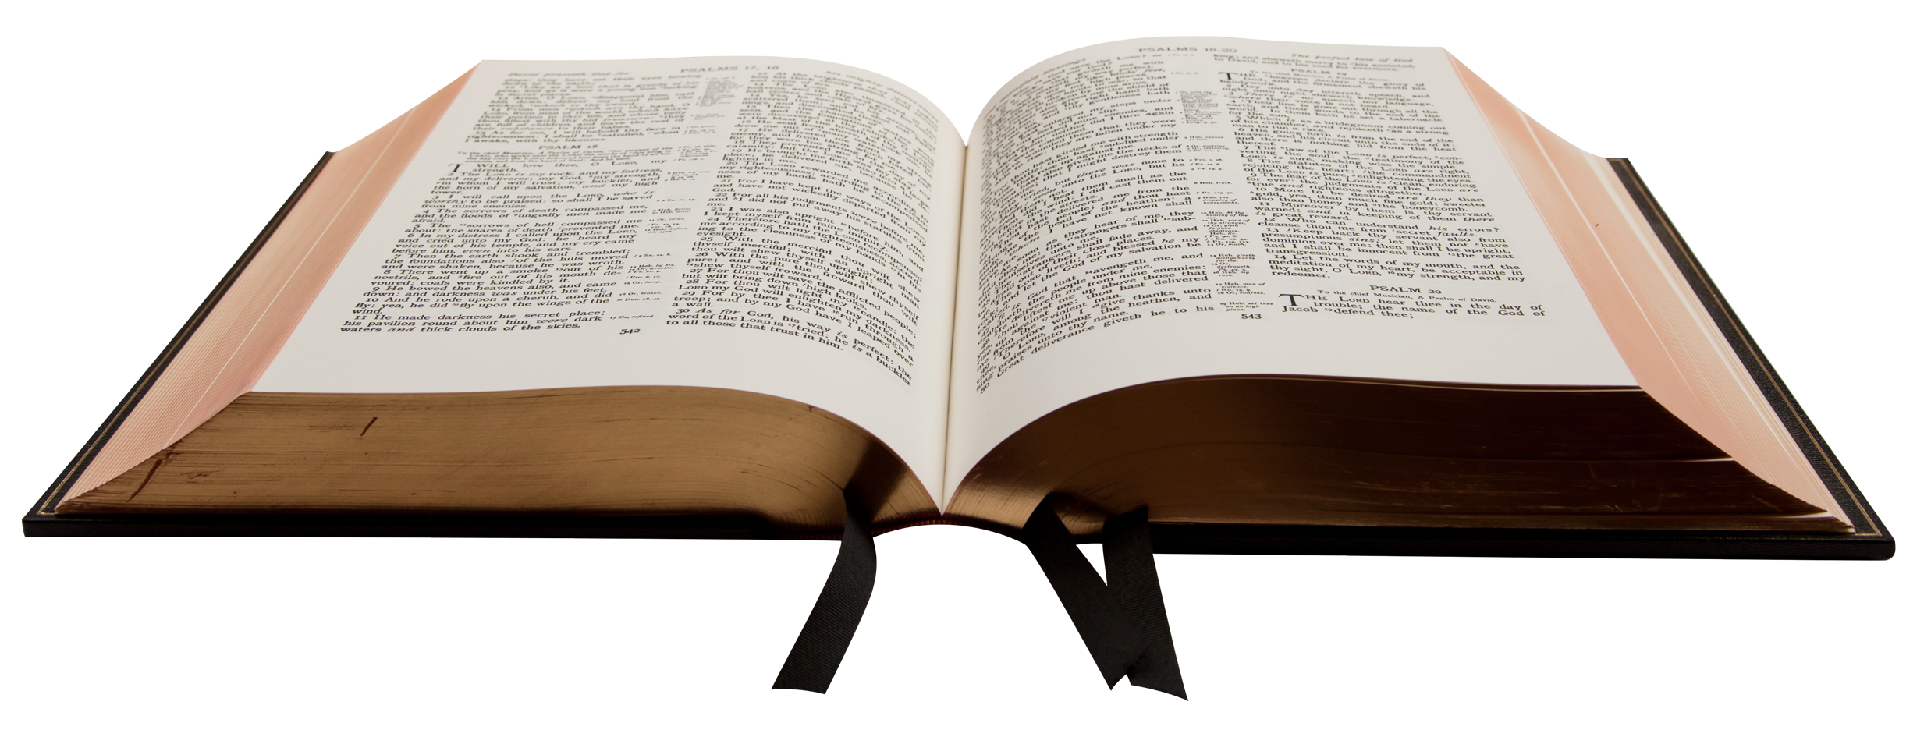
Works Prepared Beforehand
For we are His workmanship, created in Christ Jesus for good works, which God prepared beforehand that we should walk in them. Ephesians 2:10

Slide 12
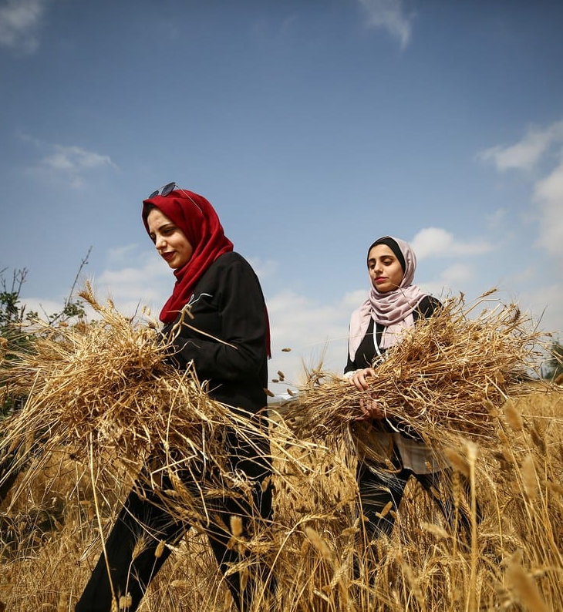
What Are Works
Things that we “do”
Things God expects of us
Our works were prepared before us

Slide 13
Works of Ephesians
1. Membership in the local church
Ephesians 4:11-16, 5:11-20
Applying a family mindset

Slide 14
Works of Ephesians
2. Keeping ourselves without sin
Ephesians 4:17-32, 5:1-10
Walking as Christ

Slide 15
Works of Ephesians
3. Pursuit of our marriage purposes
Ephesians 5:22-33
Husbands who are responsible
Wives who enable righteousness

Slide 16
Works of Ephesians
4. Honoring the home
Ephesians 6:1-4
Parents who focus on raising saints
Children who manifest honor

Slide 17
Works of Ephesians
5. Working as though unto the Lord
Ephesians 6:5-9
Working as though to the Lord
Overseeing as stewards

Slide 18
Other Works
Within these roles arise other works
Church – deacons, teachers
Home – coach, teacher
Work – supervisor, administrator

Slide 19
Other Works
Within these roles arise other works
Sometimes we lose perspective
Preacher forgets to be a husband
Parent forgets to be a worshipper

Slide 20
Other Works
Within these roles arise other works
Sometimes we lose perspective
Sometimes we feel guilty

Slide 21
Notes:
Two answers to the same question – a young mother who wants to serve God struggles with the burdens of parenthood. One answered “just do it”, the other spoke of the works that they are immediately accountable for. Who was the wise woman?

Slide 22
Works Prepared
Where are you at right now in your works?
What do you need to be doing?
What do you need to prepare yourself to do?

Slide 24
Your First Duty
Fear God and keep His commandments, For this is man's all. Ecclesiastes 12:13b

Slide 25
God’s Command
To hear and believe His Son
To confess our belief in His Son
To turn away from the path of sin
To be baptized into His Son
To abide in the doctrine of His Son

